Slide 1

Personalized MOOC Recommendations MOOCRec v2
MOOCs, chosen just for you.

Slide 2
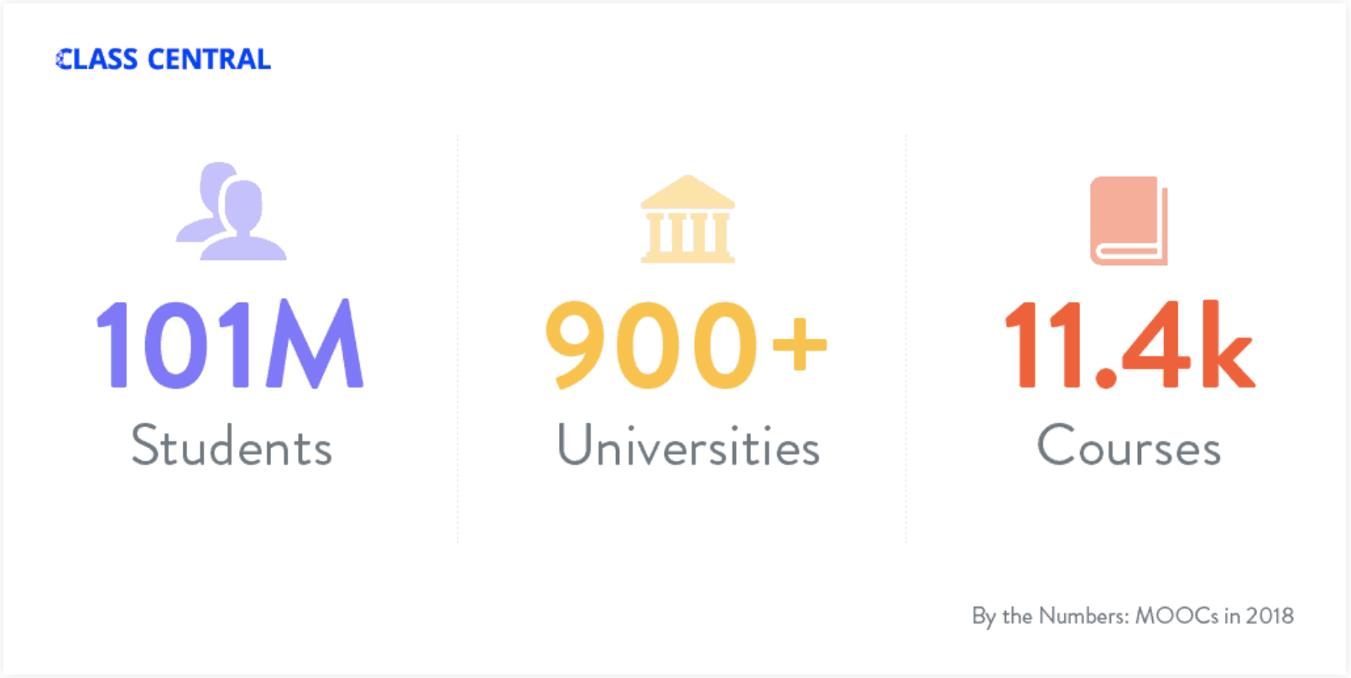
AN Overview of MOOCS
Source:
https://www.class-central.com/report/moocs-stats-and-trends-2018/
Figure 1: MOOCs Statistics from Class Central

Slide 3

Research Problem
MOOCs have different video production styles
MOOCs have a low completion rate
Consumers prefer different types of video production styles
Lack of connection between MOOC recommenders’ and consumers’ preference for video production styles
No personalization exists for MOOC recommendations

Slide 4
General objectives
Identifying user's learning styles by a more interactive method
Implement support for parallel processing to significantly improve performance
Improve MOOC recommendations based on information within discussion forums
Add support for categorizing newer & more complex video styles

Slide 5
specific objectives
Hub for MOOCs
A catalogue of MOOCs from most popular providers
Forum activity across platforms are analyzed automatically
Personalized MOOCs
Use the sentiments of other users
Parallel Image Classification
Accurately classify a wide range of video production styles
Efficiently classify using parallel processing
Identifying user's learning styles by a more interactive method

Slide 6
VIDEO PRODUCTION STYLES
MOOCs are delivered in different styles of video
Consumers may not prefer some styles of videos
Some MOOCs contain multiple video styles

Slide 7
Learning styles and dimensions
People have different styles of learning, according to Felder and Silverman
A mismatch between learning styles and video styles exists

Slide 8
MOOCREC v1
A solution proposed by a previous research
Proposed solution, MOOCRec V2 extends up on MOOCRec V1
Identifies learner styles using a lengthy questioner
Covers only a few video production styles
Inefficient video classification

Slide 9
Feature Comparison
Features | Class Central | My MOOC | MOOCRec | MOOCRec V2 Proposed Solution
Direct learning style identification | ✗ | ✗ | ✗ | ✓
Video Production Styles | ✗ | ✗ | ✓ | ✓
Complex and mixed video production styles | ✗ | ✗ | ✗ | ✓
Identify the spoken language of the presenter | ✗ | ✗ | ✗ | ✓
Search filter based on specific keywords / topics | ✗ | ✗ | ✓ | ✓
User profile and dashboard | ✗ | ✗ | ✓ | ✓
Online discussion forums analysis and extraction of sentiments of forum posts for better MOOC recommendations | ✗ | ✗ | ✗ | ✓

Slide 10
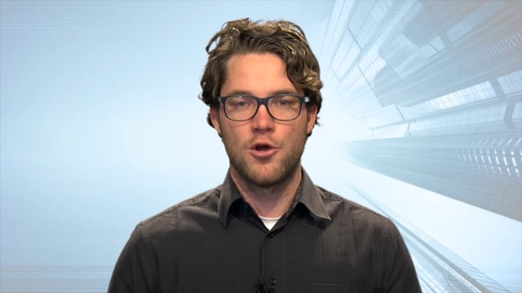
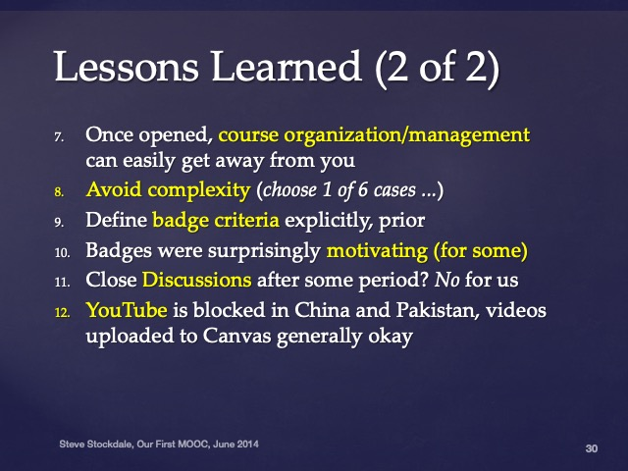

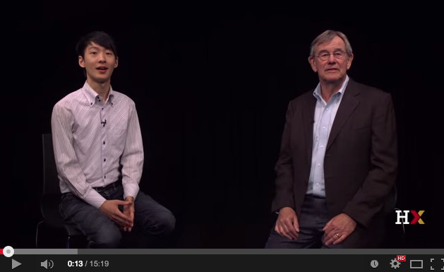
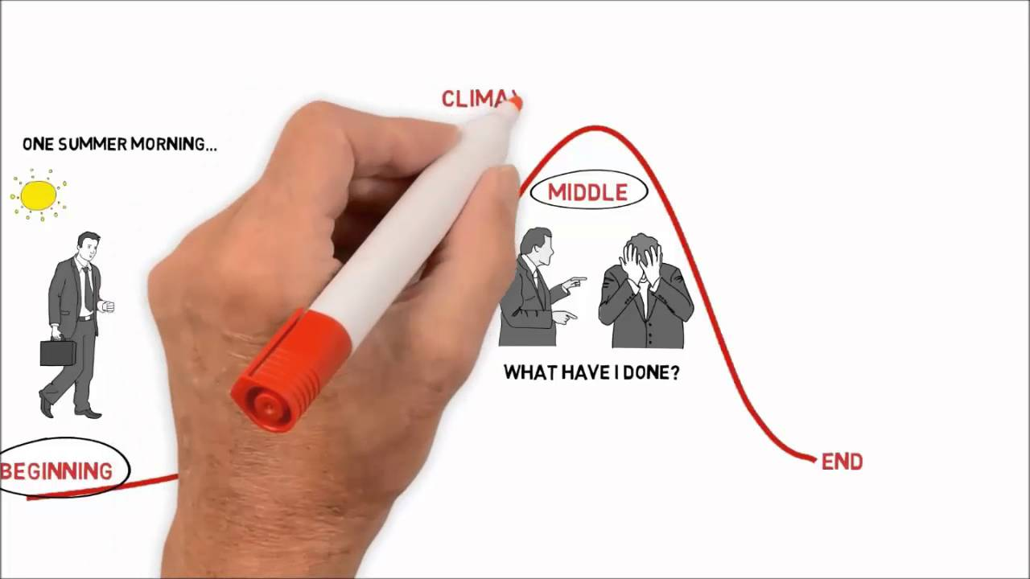
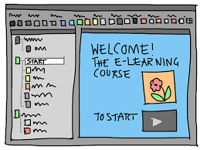

Complex Video production style classification
Different types of MOOC video production styles
Talking Head
Presentation slides with voiceover
Coding/Demonstration
Conversations
Writing
Animation

Slide 11
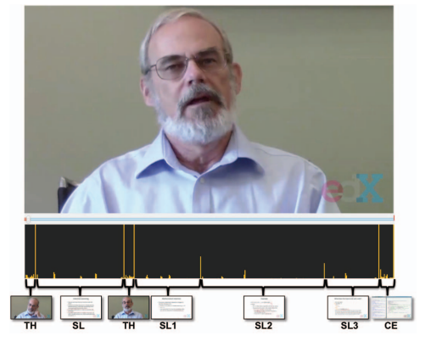
Complex Video production style classification
Some MOOC videos may contain multiple video production styles.
Identification of Percentage of each production style in a video.
Video will be split into frames and using Convolutional Neural Networks(CNN) frames will be classified.
To increase the speed and accuracy of CNN Sparse and Low-rank decomposition shot segmentation method will be used.
Figure 2: Multiple Video styles in one video

Slide 12
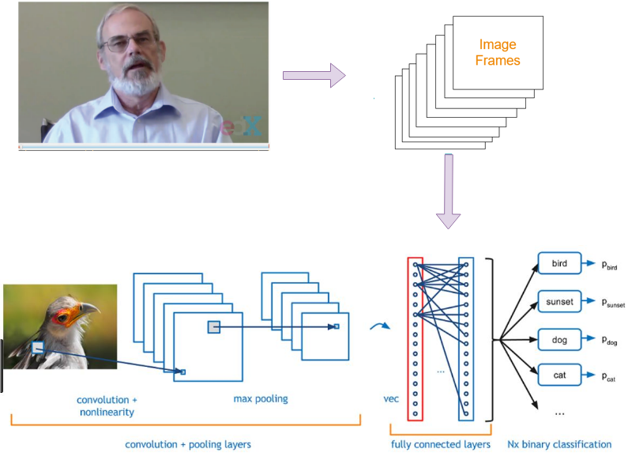
Complex Video production style classification
Figure 3 : Video Classification

Slide 13

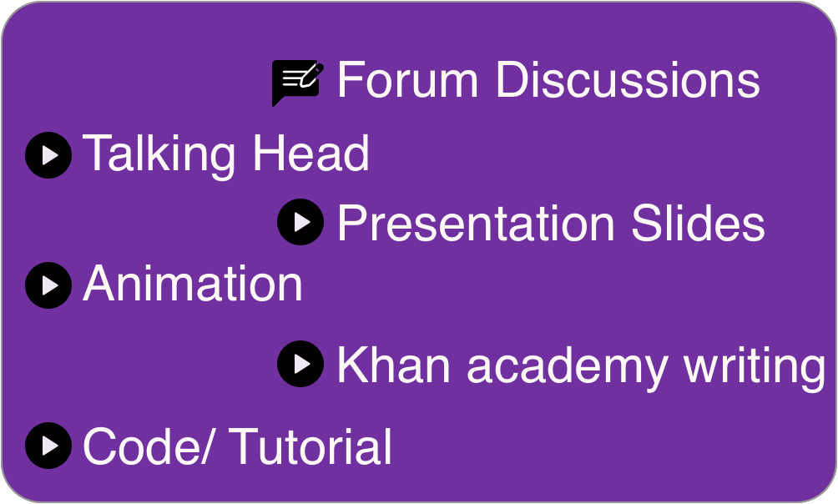
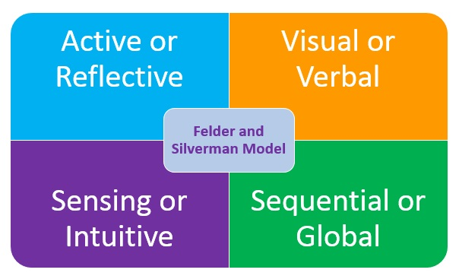

Identifying user’s preferred learning style
Identified using an interactive introductory video
Intro video contains MOOCs learning material types recognized by MOOCRec V2
Learning material types and Felder Silverman Learning Style Model are mapped
Mapping is introduced based on literature survey
Figure 6: Learning Material Type to FSLSM Mapping

Slide 14
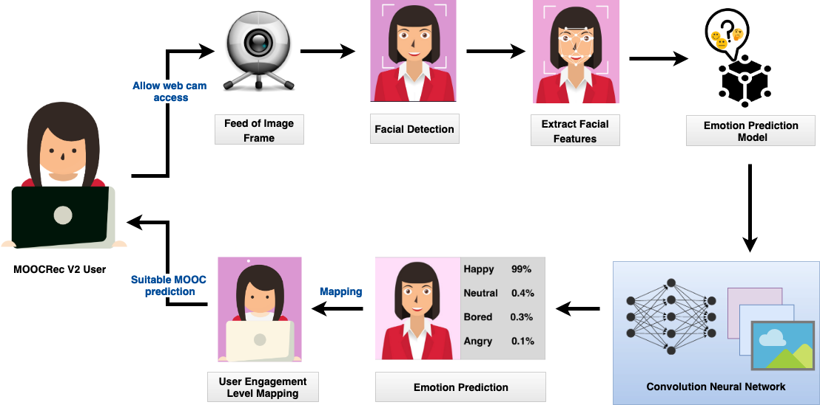
Identifying user’s preferred learning style Procedure
Figure 9 : Procedure of identifying User’s Preferred Learning Material

Slide 15
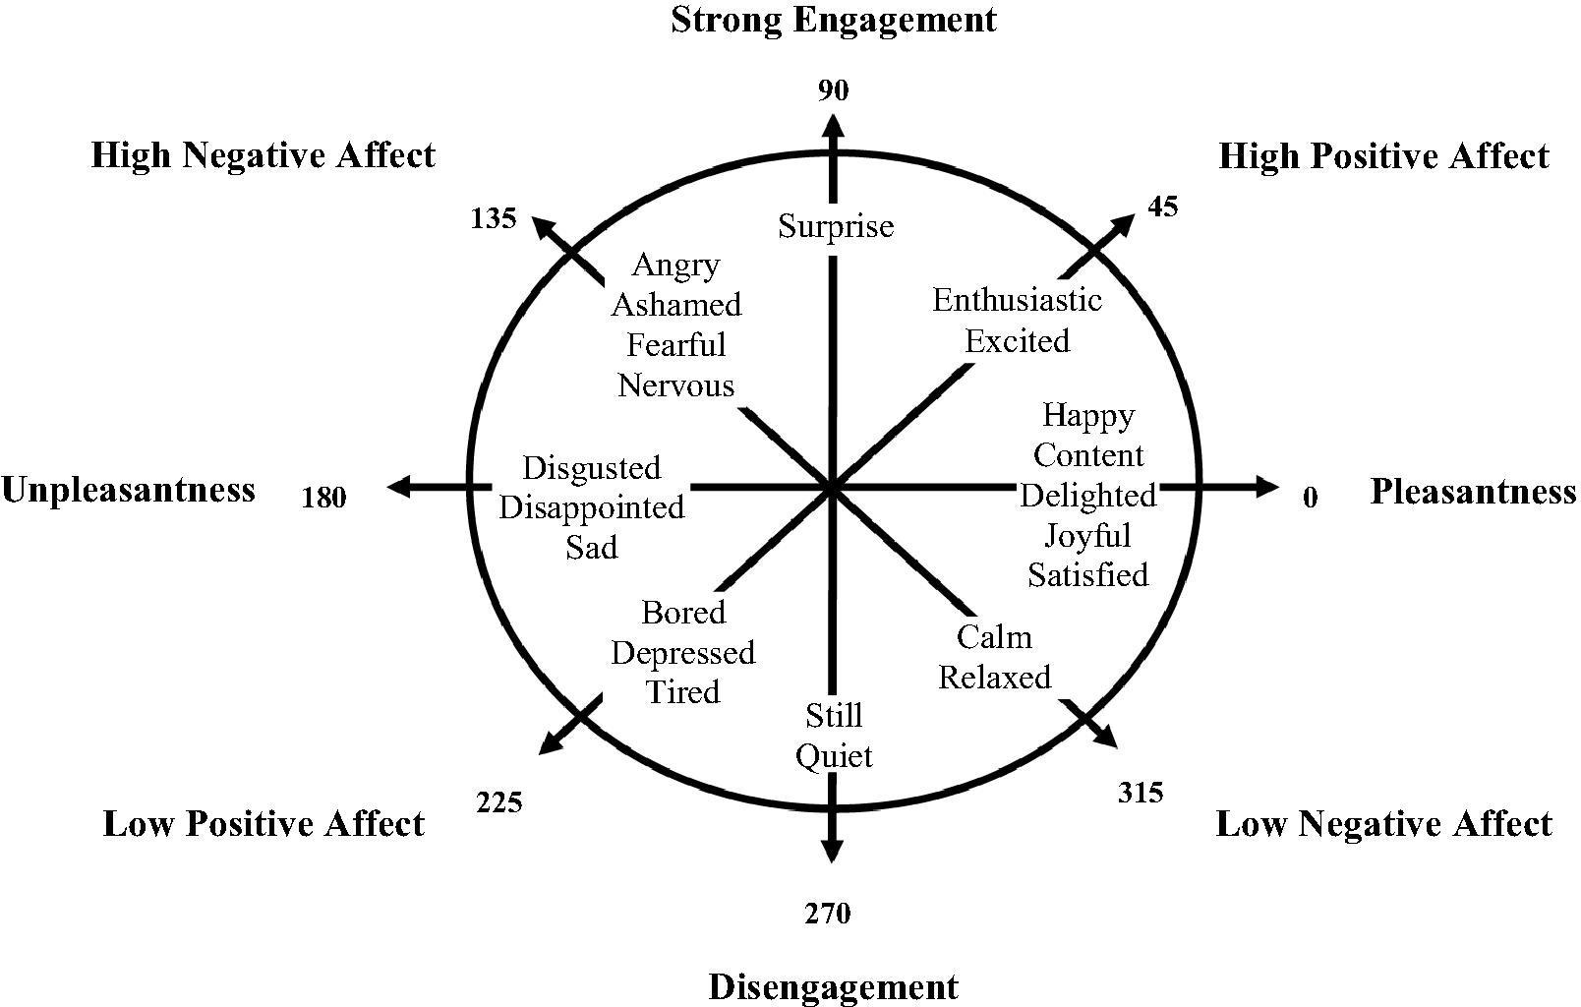
IDENTIFYING USER’S PREFERRED LEARNING STYLE
Figure 8 : Academic Emotion and User Engagement Level Mapping

Slide 16
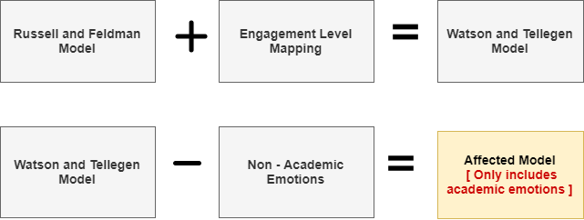
Identifying user’s preferred learning style How?
By identifying user engagement level based on facial emotions
Mapped adapting Russell and Feldman model, Watson and Tellegen Model and literature studies
Figure 7 : Procedure of deriving affected model

Slide 17
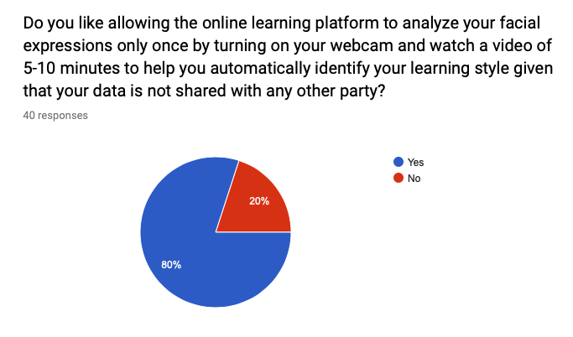
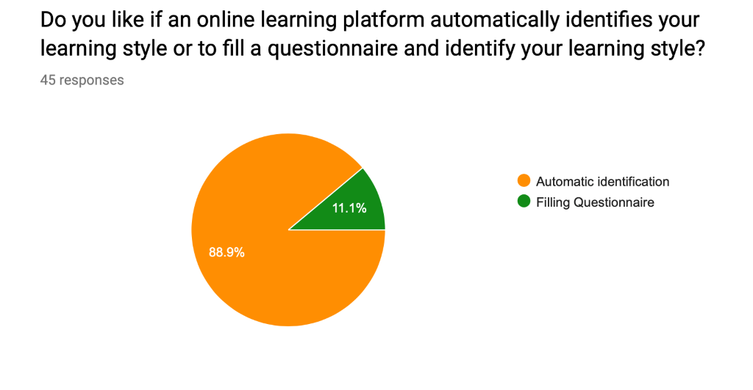
IDENTIFYING USER’S PREFERRED LEARNING STYLE Survey
Figure 4 : Survey on Filling a Questionnaire
Figure 5: Survey on Users' Willingness to Provide Temporary Web Cam Access
Source: https://docs.google.com/forms/d/e/1FAIpQLSfig75HUElsAtCSSNVxGxtzBH7j2jHXakWVn9OvOC-8sjaTgQ/viewform

Slide 18

Forum Analysis WHY?
Users who prefer learning through peer-to-peer interactions need to be recommended MOOCs which have high forum activity
Currently ratings & reviews aren't considered when recommending MOOCs in MOOCRec V1
Users who learn by peer-to-peer interactions
MOOCs with high forum activity
Figure 10: Required recommendation characteristic
Notes:
My component of the research is the analysis of forums regarding courses and their content.
The reason for this is that forums contain a large amount of information. Information which can be used when recommending MOOCs
There are basically 2 goals for this component.
One is to improve the MOOC recommendations in general which would be done using a course score
and the other is to suggest MOOCs with a higher forum activity scores to user who prefer learning through peer-to-peer interactions

Slide 19
Forum Analysis Overview
Information gathering
Using web crawlers
Analyzing user sentiments & metadata
Calculating Scores
Data Sources
Sentiments
From review-type forums
General Discussions
Metadata
Technical Discussions
Forum Activity Score
Course score (Rating)
Figure 11 : Forum Analysis Process

Slide 20








Forum Analysis Gathering Data
External Web Pages
Filter Data
Figure 12: Process of gathering required data using web crawlers

Slide 21
Forum Analysis Process
Course Score
About the course
Review-type forums (Sentiment Extraction)
Ratings from several platforms
General Discussions
Content of the course
Technical Discussions
Q & A
About the topic of the course
Technical discussions about the topic (not linked to a course)
Forum Activity Score

Slide 22
Forum Analysis Expected Result
Course | Course Score (Rating) | Forum Activity Score
Machine Learning – Coursera (Stanford Uni.) | 9.2 | 8.9
Machine Learning – Coursera (Columbia Uni.) | 7.8 | 3.2
Machine Learning - edX | 7.6 | 8.8
Machine Learning – Future Learn | 5.4 | 4.0

Slide 23
Parallel Video Classification
Over 11 400 MOOCs right now
Assuming every MOOC has one 8-minute video
24 frames per second
480 seconds per MOOC
11 520 frames per MOOC
131 328 000 image frames to Analyze
Analyzing using a single-threaded/monolithic architecture can
Cause loss of progress if the classifier crashes
Underutilize processing power available
Hard to scale to meet increasing/decreasing demands

Slide 24
Parallel Video Classification
With parallelized, independent docker containers
Workload is distributed
Workload is independent
No loss of progress by using Message Queues
Can scale up or down with ease
Ability to run two differently trained classifiers/techniques on the same data set

Slide 25
Parallel Video Classification Techniques
SIMD
Single Instruction Multiple Data-stream
SISD
Single Instruction Single Data-stream
MIMD
Multiple Instructions Multiple Data-stream
MISD
Multiple Instructions Single Data-stream

Slide 26
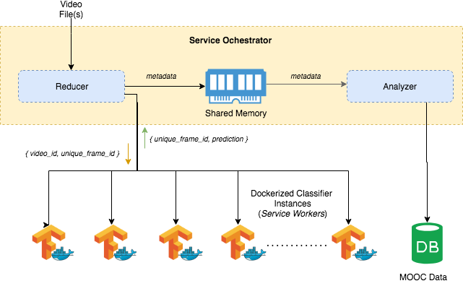
Parallel Video Classification Approach 1
Figure 13: Shared memory orchestrator with distributed service workers

Slide 27
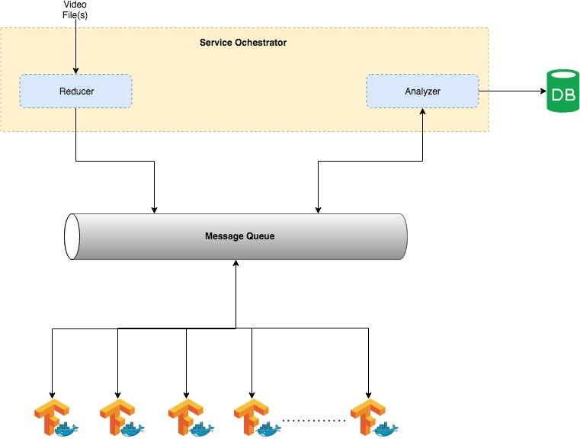
Parallel Video Classification Approach 2
Use a Message Queue to direct work to classifiers
Increase scalability
Work progress is persistent
Figure 14: Distributed service workers and orchestrator with a message queue

Slide 28
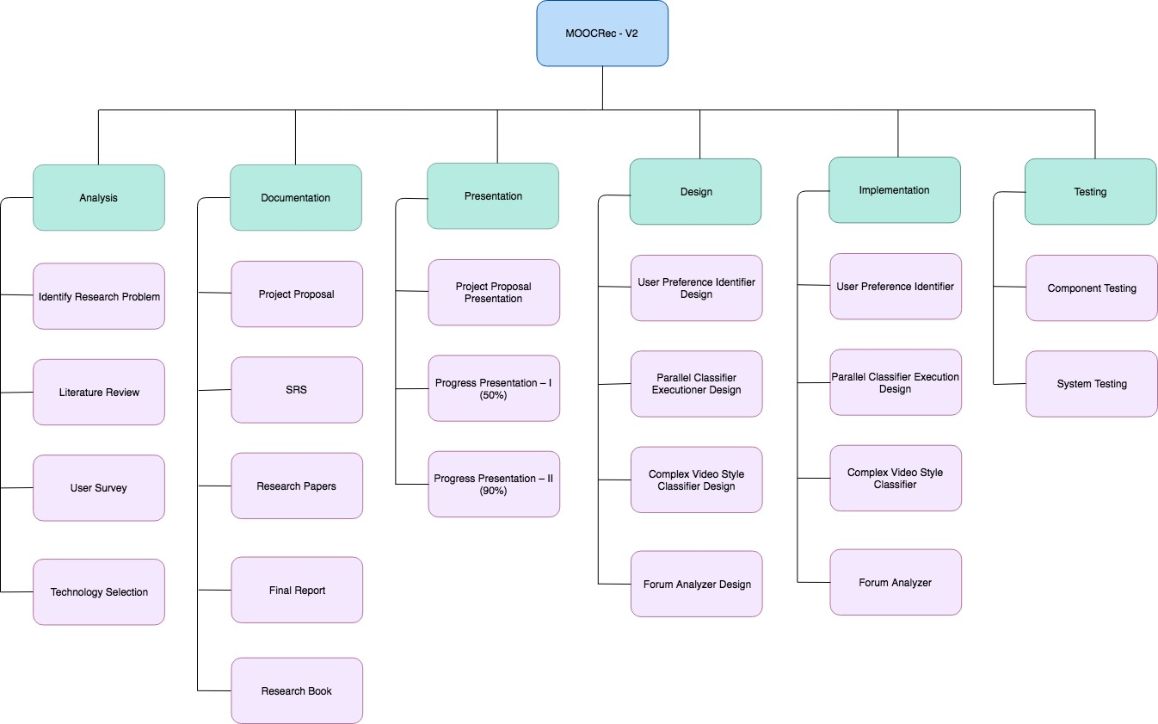
Work Breakdown structure
Figure 15: Distributed service workers and orchestrator with a message queue

Slide 29
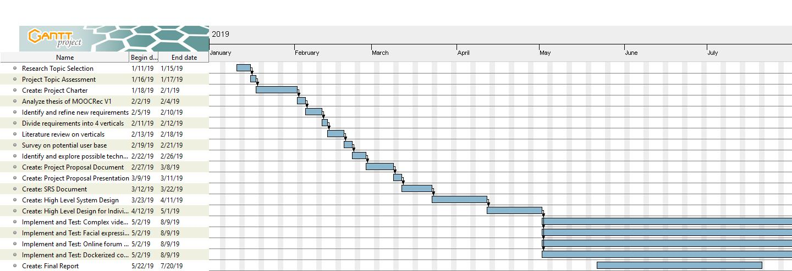
Gantt Chart
Figure 16: Gantt Chart

